Slide 1
Bronx Community Health Dashboard: Violence Last Updated: 9/24/2019 See last slide for more information about this project.

Slide 2
Youth Violence

Slide 3
Bronx youth are most likely to report skipping school because they felt unsafe
---------------------------------------------------Bronx only---------------------------------------------------
Data source: NYC Youth Risk Behavior Survey, 2017.
*Indicates estimate is statistically imprecise (interpret with caution).
Non-Hispanic other includes non-Latino students who selected American Indian/Alaska Native, Native Hawaiian/other Pacific Islander, or multiple race categories.

Slide 4
While a similar proportion of Bronx youth are bullied on school property as other boroughs, the proportion is higher for Bronx girls than boys
---------------------------------------------------Bronx only---------------------------------------------------
Data source: NYC Youth Risk Behavior Survey, 2017.
*Indicates estimate is statistically imprecise (interpret with caution).
Non-Hispanic other includes non-Latino students who selected American Indian/Alaska Native, Native Hawaiian/other Pacific Islander, or multiple race categories.

Slide 5
In the Bronx, girls are more likely to experience bullying on school property and online than boys
Data source: New York City Youth Risk Behavior Survey, 2009-2017

Slide 6
Girls and non-Hispanic white, Asian and other youth are most likely to report being cyber bullied in the Bronx
---------------------------------------------------Bronx only---------------------------------------------------
Data source: NYC Youth Risk Behavior Survey, 2017.
*Indicates estimate is statistically imprecise (interpret with caution).
Non-Hispanic other includes non-Latino students who selected American Indian/Alaska Native, Native Hawaiian/other Pacific Islander, or multiple race categories.

Slide 7
The percentage of youth in the Bronx carrying weapons has fallen over the last 12 years
Data source: New York City Youth Risk Behavior Survey, 2003-2017
Data captured biennially and not available before 2003.
Percent carrying a gun in the last 30 days not captured after 2015.

Slide 8
Boys are twice as likely to carry a weapon and nearly 4 times as likely to carry a gun as girls in the Bronx
Data source: New York City Youth Risk Behavior Survey, 2003-2017.
Data captured biennially and not available before 2003.
Percent carrying a gun in the last 30 days not captured after 2015.

Slide 9
The percent of youth reporting physically fighting in the past year has declined across the city, but remains highest in the Bronx
Data source: New York City Youth Risk Behavior Survey, 2003-2017

Slide 10
In the Bronx, boys and those in the 9th grade are most likely to report physically fighting in the past year
---------------------------------------------------Bronx only---------------------------------------------------
Data source: NYC Youth Risk Behavior Survey, 2017.
*Indicates estimate is statistically imprecise (interpret with caution).
Non-Hispanic other includes non-Latino students who selected American Indian/Alaska Native, Native Hawaiian/other Pacific Islander, or multiple race categories.

Slide 11
The percent of Bronx youth that experience physical dating violence is higher for girls and those in the 10th grade
---------------------------------------------------Bronx only---------------------------------------------------
Data source: NYC Youth Risk Behavior Survey, 2017.
*Indicates estimate is statistically imprecise (interpret with caution).
Non-Hispanic other includes non-Latino students who selected American Indian/Alaska Native, Native Hawaiian/other Pacific Islander, or multiple race categories.

Slide 12
Girls and Hispanic youth are more likely to report experiencing sexual dating violence in the Bronx
---------------------------------------------------Bronx only---------------------------------------------------
Data source: NYC Youth Risk Behavior Survey, 2017.
*Indicates estimate is statistically imprecise (interpret with caution).
Non-Hispanic other includes non-Latino students who selected American Indian/Alaska Native, Native Hawaiian/other Pacific Islander, or multiple race categories.

Slide 13
Violent Crimes

Slide 14
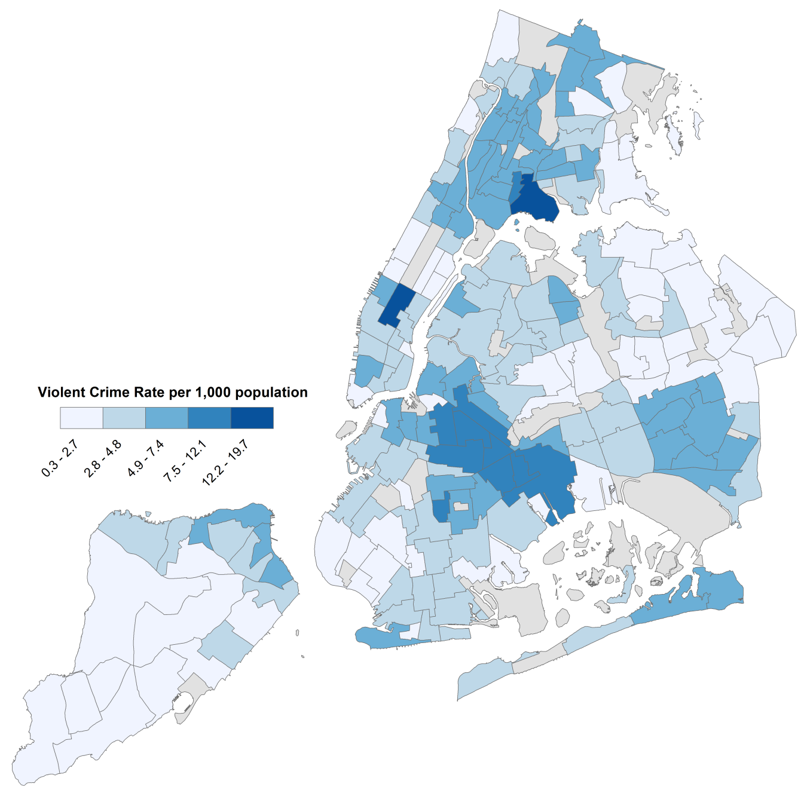
The violent crime rate is highest in Midtown South in Manhattan and Hunts Point in the Bronx
Data source: NYPD Complaint 2014 data from the NYC Neighborhood Health Atlas; violent crime includes felony murder, assault, and robbery. Excludes rape due to insufficient information to geocode.

Slide 15
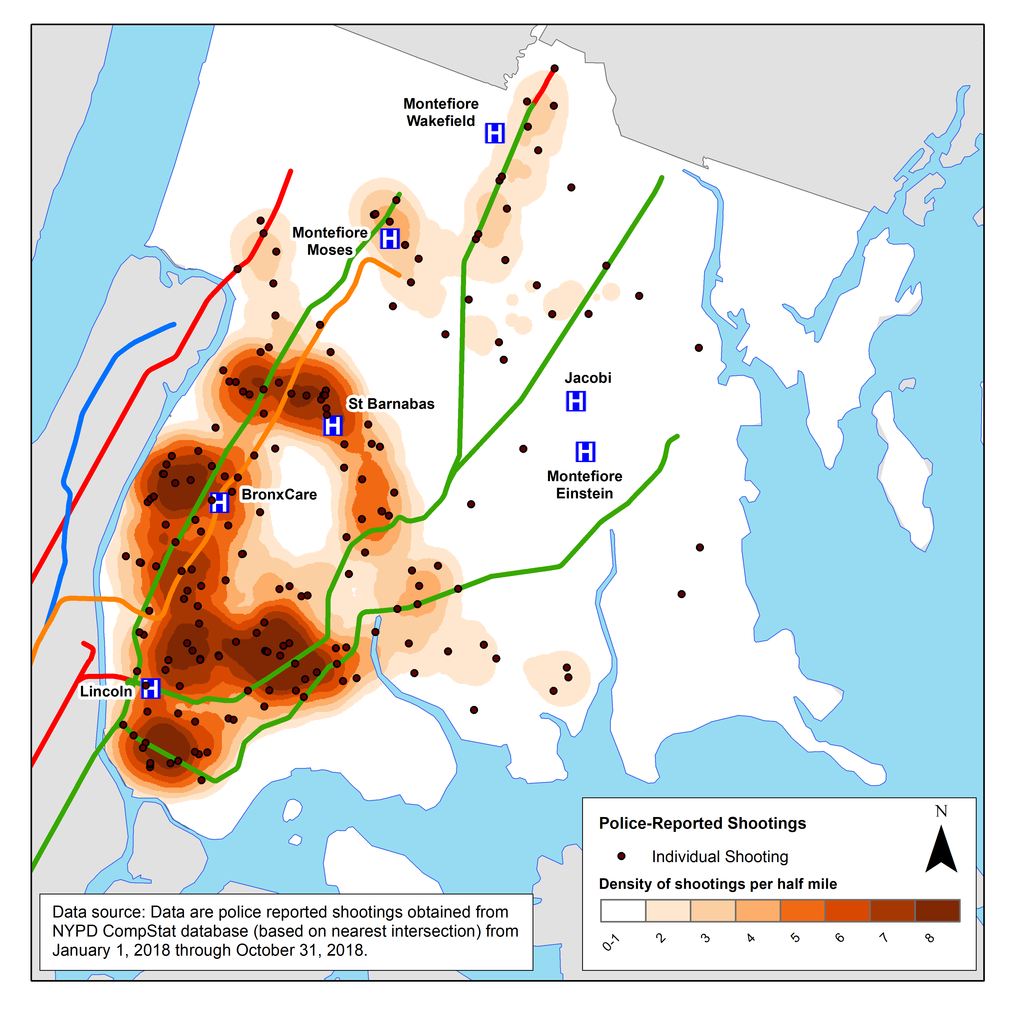
Most shootings occur in the southern and western portions of the Bronx

Slide 16
The rate of felony assaults* remains far higher in the Bronx than the rest of NYC
Data source: Citywide Seven Major Felony Offenses Historical NYC Crime Data, 2000-2018; population estimates from U.S. Census (2000, 2010-2018) and American Community Survey (for 2005)
*Offenses do not indicate convictions

Slide 17
The rate of murder and non-negligent homicide is highest in the Bronx, but declined by 54% between 2000 and 2018
Data source: Citywide Seven Major Felony Offenses Historical NYC Crime Data, 2000-2018; population estimates from U.S. Census (2000, 2010-2018) and American Community Survey (for 2005)

Slide 18
The rate of rape* is highest in the Bronx, reports having slightly increased in most boroughs since 2014
Data source: NYPD data obtained by E.W. Scripps Company in 2019; population estimates from U.S. Census.
*Rape based on a definition updated in 2012 by the FBI to include men and forcible anal and oral penetration.

Slide 19
Assault Hospitalizations

Slide 20
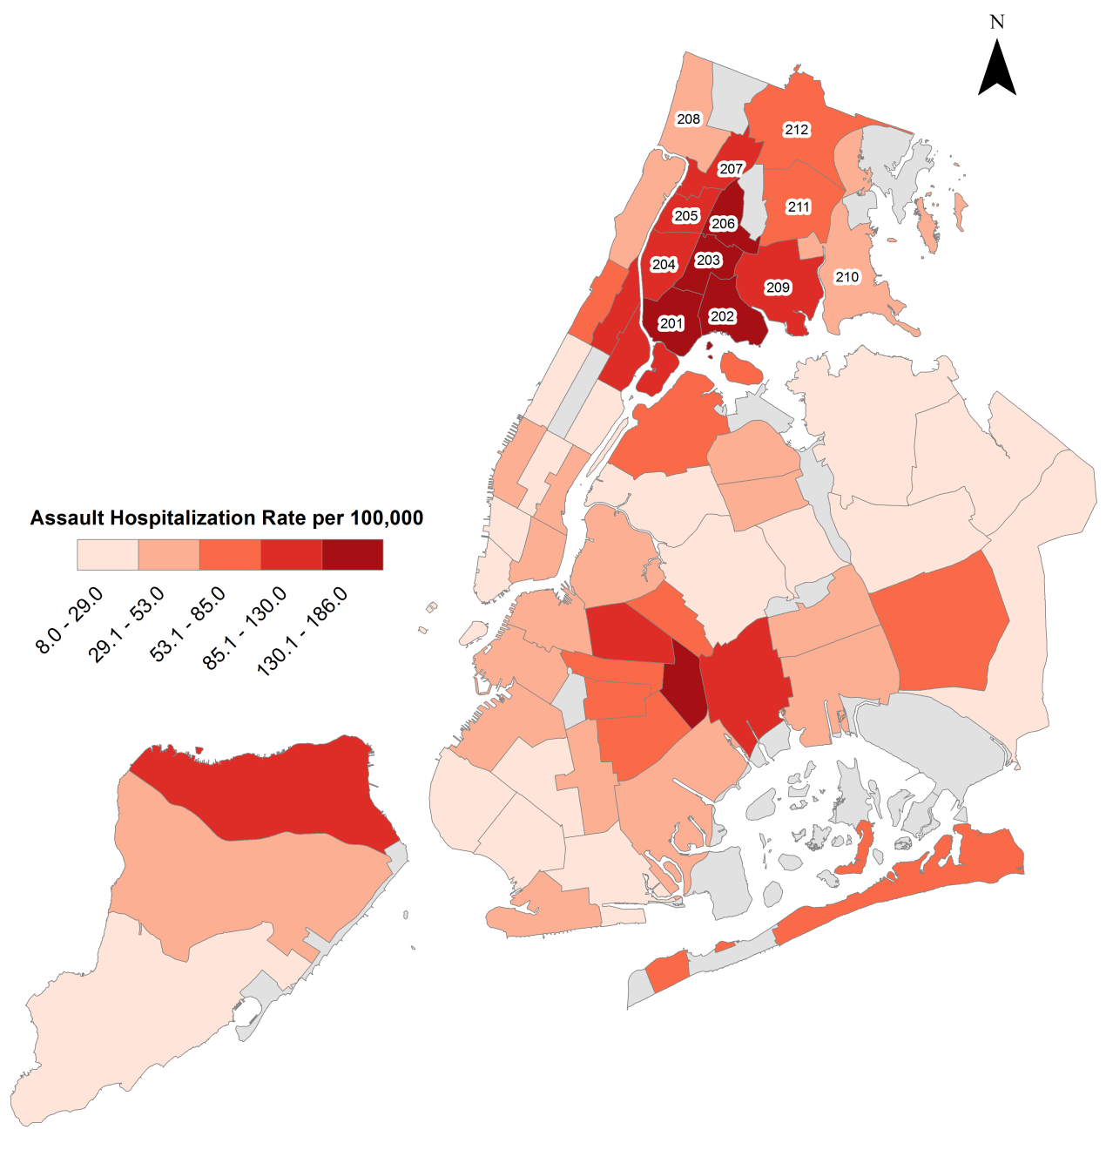
6 of 10 Community Districts with the highest rates of assault hospitalizations are in the Bronx
201 | Mott Haven & Melrose
202 | Hunts Point & Longwood
203 | Morrisania & Crotona
204 | Highbridge & Concourse
205 | Fordham & University Heights
206 | Belmont & East Tremont
207 | Kingsbridge Heights & Bedford
208 | Riverdale & Fieldston
209 | Parkchester & Soundview
210 | Throgs Neck & Co-op City
211 | Morris Park & Bronxdale
212 | Williamsbridge & Baychester
Data source: SPARCS hospital discharge data (2012-2014) from New York City Community Health Profiles, 2018 and race/ethnicity data form New York State Prevention Agenda Dashboard.

Slide 21
Intimate Partner & Family Violence

Slide 22
Between 2010 and 2017, the rate of domestic violence homicide was highest for Bronx residents and those ages 0-10y, and girls and non-Hispanic black
All of New York City
Data source: 2010-2017, from the 2018 NYC Domestic Violence Fatality Review Committee Reports.
Population estimates modified from 2013-2017 5-year American Community Survey Estimates.
*Domestic violence homicides includes both intimate partner homicide and other family-related homicide.

Slide 23
Between 2010 and 2017, the rate of intimate partner homicide was highest for Bronx residents and those ages 40-49, girls and non-Hispanic black
All of New York City
Data source: 2010-2017, from the 2018 NYC Domestic Violence Fatality Review Committee Reports.
Population estimates modified from 2013-2017 5-year American Community Survey Estimates.
Intimate partners defined as relationships between those who are married/divorced/dating/have a child in common

Slide 24
Between 2010 and 2017, the rate of other family-related homicide was significantly higher for Bronx, non-Hispanic black residents and those ages 0-10y
All of New York City
Data source: 2010-2017, from the 2018 NYC Domestic Violence Fatality Review Committee Reports.
Population estimates modified from 2013-2017 5-year American Community Survey Estimates.
Other family relationships defined as those who are related by marriage or blood

Slide 25
Method/weapon for domestic violence homicides, 2010-2017
Intimate Partner Homicides
Other Family Homicides*
Firearms accounted for 60.4% of all homicides in NYC, compared to 20% for family-related homicides
Data from 2010-2017. Compiled from the 2018 NYC Domestic Violence Fatality Review Committee Reports. Data is for all of NYC, not specific to the Bronx.
*Data is for 2010-2015, compiled from the 2016 NYC Domestic Violence Fatality Review Committee Reports.
Domestic violence homicides includes both intimate partner homicide and other family-related homicide.

Slide 26
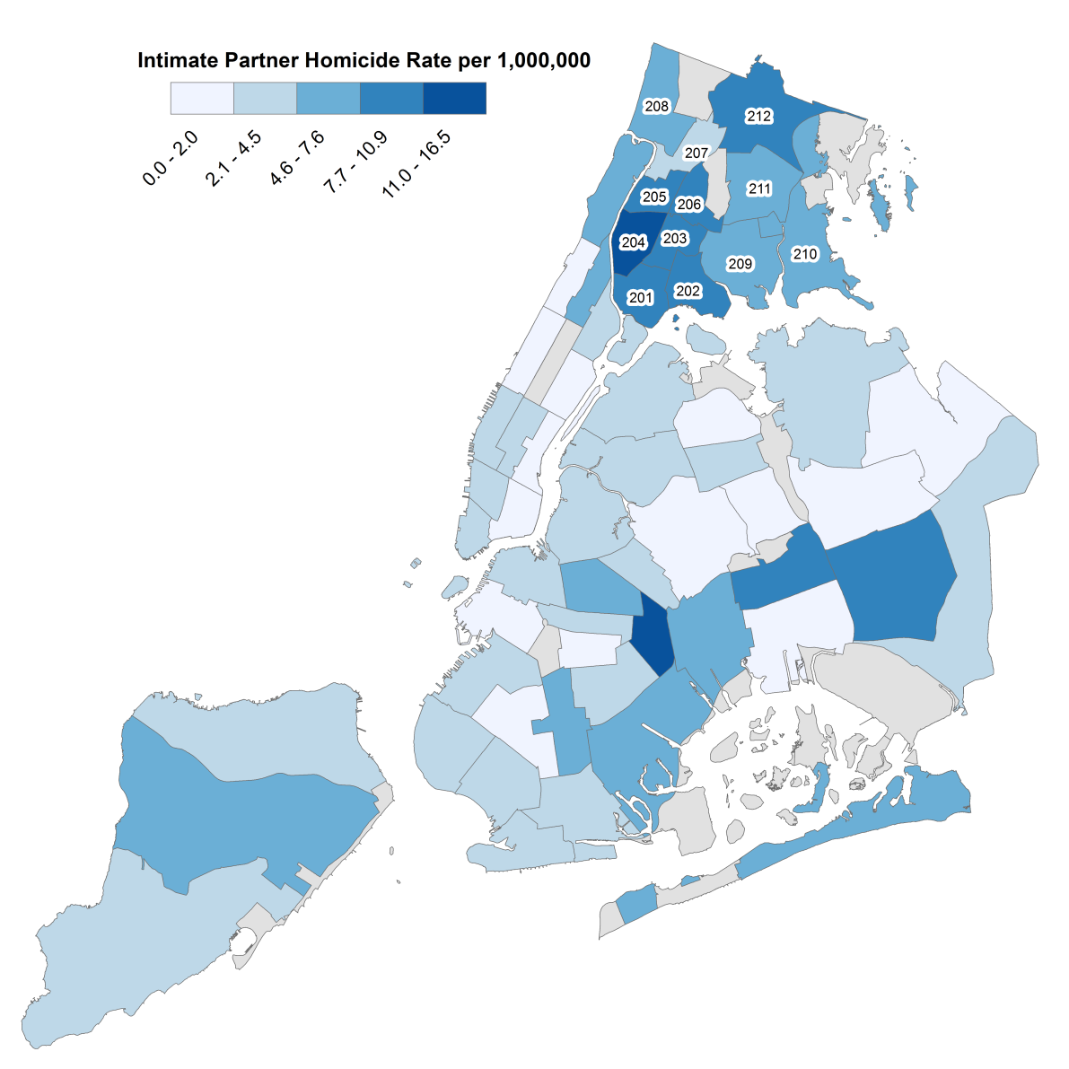
41% of family-related homicides occurred in 10 Community Districts, half of which are in the Bronx
Data source: 2010-2016 data provided by NYPD; extracted from the 2017 NYC Domestic Violence Fatality Review Committee Reports.

Slide 27
Assault Mortality

Slide 28
Assault-related mortality rates have fallen in the Bronx; they are now lower than national rates but higher than the rest of NYC
Data source: Underlying Cause of Death, 2000-2017. Rates for Staten Island are unstable 2002-2004; 2007; 2011-2017.

Slide 29
Assault-related mortality rates are highest for men, non-Hispanic black residents and those ages 15-24
------------Age-Adjusted----------
------------Age-Adjusted----------
Data source: Underlying Cause of Data, 2013-2017
Data on other race/ethnicities not shown due to small sample size.
Age results are not age-adjusted

Slide 30
Age and race/ethnicity differences in assault mortality are more profound among men as compared to women
Data source: Underlying Cause of Death, 2013-2017.
Data on other race/ethnicities not shown due to small sample size.
Age-results not age-adjusted.

Slide 31
While assault-related mortality has declined for all residents ages 15-54, it remains highest for those ages 15-24
Data source: Underlying Cause of Death, 2000-2017.
Data are not shown for other ages due to small numbers.

Slide 32
Racial/ethnic disparities in assault-related mortality have declined over the past two decades
Data source: Underlying Cause of Death, 2000-2017.
Data for non-Hispanic white population statistically unstable from 2008 onwards.

Slide 33
Although declining, firearm assault remains the largest contributor to assault-related mortality rates in the Bronx
Findings are similar to that of NYC, excluding the Bronx
Data source: Underlying Cause of Death, 2013-2017.

Slide 34
About the Community Health Dashboard Project
The goal of the project is to provide Bronx-specific data on risk factors and health outcomes with an emphasis on presenting data on trends, socio-demographic differences (e.g., by age, sex, race/ethnicity, etc.) and sub-county/neighborhood level data
Data will be periodically updated as new data becomes available.
Produced by Montefiore’s Office of Community & Population Health using publicly-available data sources
For more information, please contact us at OCPHDept@montefiore.org

